Slide 1
Disclaimer
This training resource was developed to be used with the CZ ID platform
In October, 2026, stewardship of CZ ID transitioned to UCSF and the platform was renamed to SeqtoID
These training materials are not being actively maintained and may not reflect differences between CZ ID and SeqtoID, subsequent changes to the platform, or current methods and best practices in metagenomic sequencing and analysis

Slide 2

Bioinformatic Basics and mNGS Pipeline Information
Rapid Response – Updated Sept 2026
Notes:
Slides updated 07/02/2024

Slide 3
Outline
Review NGS workflow
  Whole genome sequencing (WGS) vs metagenomic NGS (mNGS)
Pipeline basics
Walk through CZ ID mNGS pipeline steps

Slide 4
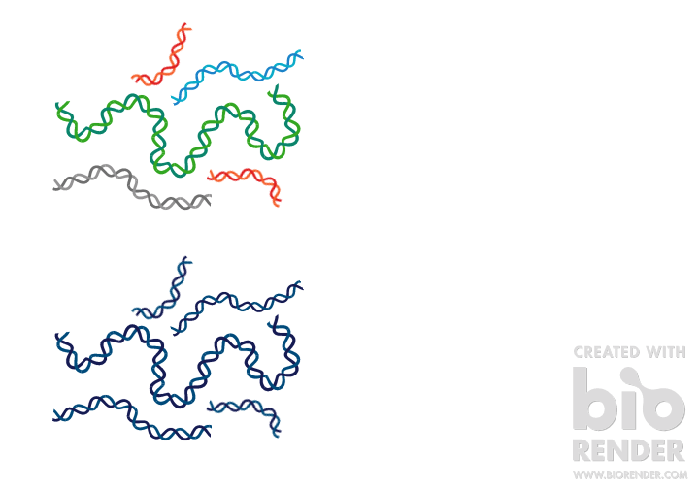
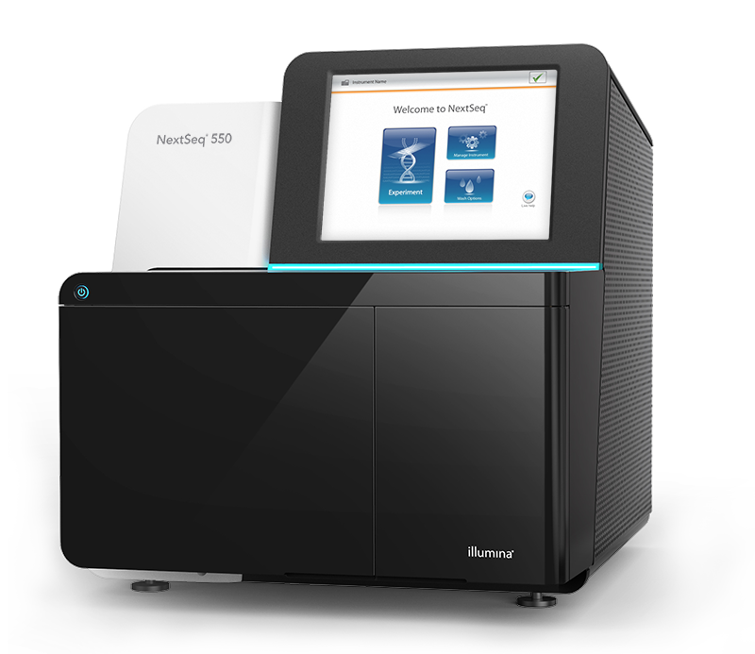
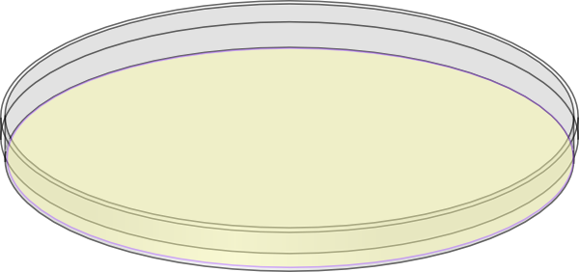
WGS vs mNGS Workflow Overview
Sample Collection
DNA or RNA Extraction
Library
Preparation
Sequencing
Bioinformatic Analysis
Genome Assembly
Variant Analysis
WGS

Slide 5
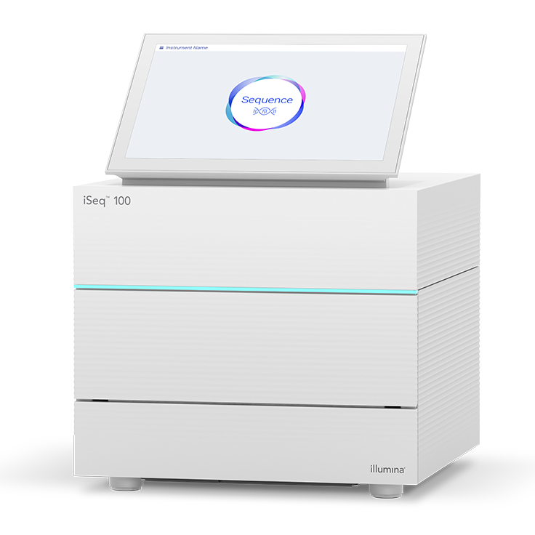
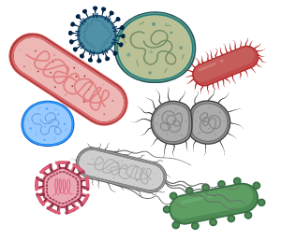
WGS vs mNGS Workflow Overview
Sample Collection
DNA or RNA Extraction
Library
Preparation
Sequencing
Bioinformatic Analysis
Genome Assembly
Variant Analysis
WGS
Taxonomic Identification
Microbiome analysis
Discovery
mNGS

Slide 6
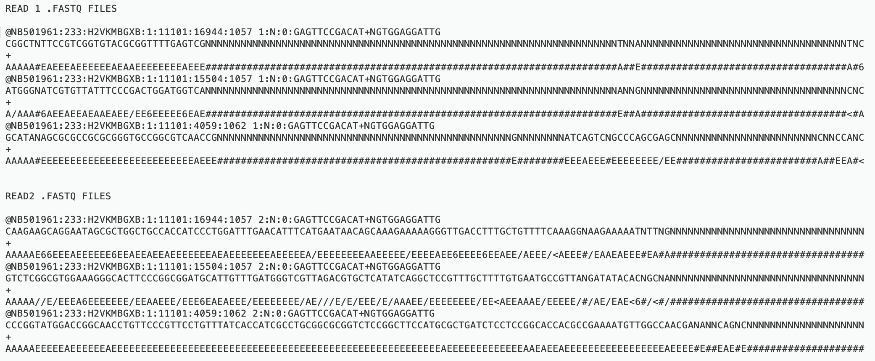
Raw sequencing reads: FASTQ format

Slide 7
FASTQ format
Example Read1.fastq
@NB501961:14:HM7TLBGX2:1:11102:3233:17234 1:N:0:GATCACCA+GATCACCA
CATTCGGCTGGGTTTCGTCACCCTGCGGGAAGATGCGGGTCCAGGCGATAGAGGTGCGGAAGCATTTGAAGCCCA
+
AAAAAEEEEEEEEEE/EEEEEEEEEEEEEEEEEEEEEE<EEEEEEEEE//EAEEEEEEAA/EEE/EEAAEEE<6/
Quality Score | Probability of Incorrect Base Call | Inferred Base Call Accuracy
10 (Q10) | 1 in 10 = 10% | 90%
20 (Q20) | 1 in 100 = 1% | 99%
30 (Q30) | 1 in 1000 = 0.1% | 99.9%
A sequence identifier with information about the run.
The base calls: A, C, T, G and N.
A separator, which is simply a plus (+) sign.
The base call quality scores (coded in ASCII format)
Q = -10log₁₀(e)
Notes:
@<instrument>:<run number>:<flowcell ID>:<lane>:<tile>:<x-pos>:<y-pos> <read>:<is filtered>:<control number>:<sample number>

Slide 8
How many reads are listed here?
File: Sample_R1.fastq
@NB501961:14:HM7TLBGX2:1:11102:3233:17234 1:N:0:GATCACCA+GATCACCA
CATTCGGCTGGGTTTCGTCACCCTGCGGGAAGATGCGGGTCCAGGCGATAGAGGTGCGGAAGCATTTGAAGCCCATCTCGGCGATCAGTTTGATGTCTTCTTTGTAGCGACCGTAGAAGTCGACGGCTTCGTGGTTCGGGTAGTATTTTN
+
AAAAAEEEEEEEEEE/EEEEEEEEEEEEEEEEEEEEEE<EEEEEEEEE//EAEEEEEEAA/EEE/EEAAEEE<6/<AEE<E<A//EEEEEAEE<EA/<AA//EAAEAAE<E/EAEE///E<A/<AA//A<A<<A6<A//AA/E////6A#
@NB501961:14:HM7TLBGX2:1:11103:13923:13163 1:N:0:GATCACCA+GATCACCA
GAACTGGAGCTTTAGCCCGGTGATCCTGTGCCTCATTTGTATGGCTACCGCCATGGTGATGTACCTGCCATTTCTCAAAGCTTACGAAAAACAGCTGCTGGCCCAGGAGCGTGAAAACGCCGTCGGCCAGGCTGACAACGCGGCGCAGAN
+
AAAAAEEEEEEEEEEEEAEEEEEEEEEEEEEAEEEEEEEEEEEEEEEEEEE/EEEEEEAAAEAEAEEAEEAEEEEEEEEEEEEEEEAAEEEEEEEEEEEEEEA<EEEEEEEAE<AEAEEAA<AAEEAEEEAE/6/A/EEEE/EEE<AE/#
@NB501961:14:HM7TLBGX2:1:11104:15318:11334 1:N:0:GATCACCA+GATCACCA
GATAGTGCTGTTCGCGAGCGATCGCCAGTACGCGCTCGCGCGTCTCCTGCGCCACGCGCAGCTCTTTACCACGACCGTTGAGTACCAGGCTGGCGGTCGCTTTGGAGACGCCCGCCAGTTCGGCGATATCTTTGATAGTTACGCGTTTGG
+
AAAAAEEEEEEEAEEEAEEEEEEEEEEEEEEEEEEEEEEEEEEEEEEEEEEEEEEEEEEAEEAEE<EAEE/EE/EEE<AEEEE/EEEEEEEEEEEE/EEE//AEE<E/EEEEAEEA/E<<AEEEE/<66A///<</AA<//6AE<<6/<6

Slide 9
How do we get from here...
sample_R1.fastq
@NB501961:14:HM7TLBGX2:1:11102:3233:17234 1:N:0:GATCACCA+GATCACCA
CATTCGGCTGGGTTTCGTCACCCTGCGGGAAGATGCGGGTCCAGGCGATAGAGGTGCGGAAGCATTTGAAGCCCATCTCGGCGATCAGTTTGATGTCTTCTTTGTAGCGACCGTAGAAGTCGACGGCTTCGTGGTTCGGGTAGTATTTTN
+
AAAAAEEEEEEEEEE/EEEEEEEEEEEEEEEEEEEEEE<EEEEEEEEE//EAEEEEEEAA/EEE/EEAAEEE<6/<AEE<E<A//EEEEEAEE<EA/<AA//EAAEAAE<E/EAEE///E<A/<AA//A<A<<A6<A//AA/E////6A#
@NB501961:14:HM7TLBGX2:1:11103:13923:13163 1:N:0:GATCACCA+GATCACCA
GAACTGGAGCTTTAGCCCGGTGATCCTGTGCCTCATTTGTATGGCTACCGCCATGGTGATGTACCTGCCATTTCTCAAAGCTTACGAAAAACAGCTGCTGGCCCAGGAGCGTGAAAACGCCGTCGGCCAGGCTGACAACGCGGCGCAGAN
+
AAAAAEEEEEEEEEEEEAEEEEEEEEEEEEEAEEEEEEEEEEEEEEEEEEE/EEEEEEAAAEAEAEEAEEAEEEEEEEEEEEEEEEAAEEEEEEEEEEEEEEA<EEEEEEEAE<AEAEEAA<AAEEAEEEAE/6/A/EEEE/EEE<AE/#
@NB501961:14:HM7TLBGX2:1:11104:15318:11334 1:N:0:GATCACCA+GATCACCA
GATAGTGCTGTTCGCGAGCGATCGCCAGTACGCGCTCGCGCGTCTCCTGCGCCACGCGCAGCTCTTTACCACGACCGTTGAGTACCAGGCTGGCGGTCGCTTTGGAGACGCCCGCCAGTTCGGCGATATCTTTGATAGTTACGCGTTTGG
+
AAAAAEEEEEEEAEEEAEEEEEEEEEEEEEEEEEEEEEEEEEEEEEEEEEEEEEEEEEEAEEAEE<EAEE/EE/EEE<AEEEE/EEEEEEEEEEEE/EEE//AEE<E/EEEEAEEA/E<<AEEEE/<66A///<</AA<//6AE<<6/<6

Slide 10
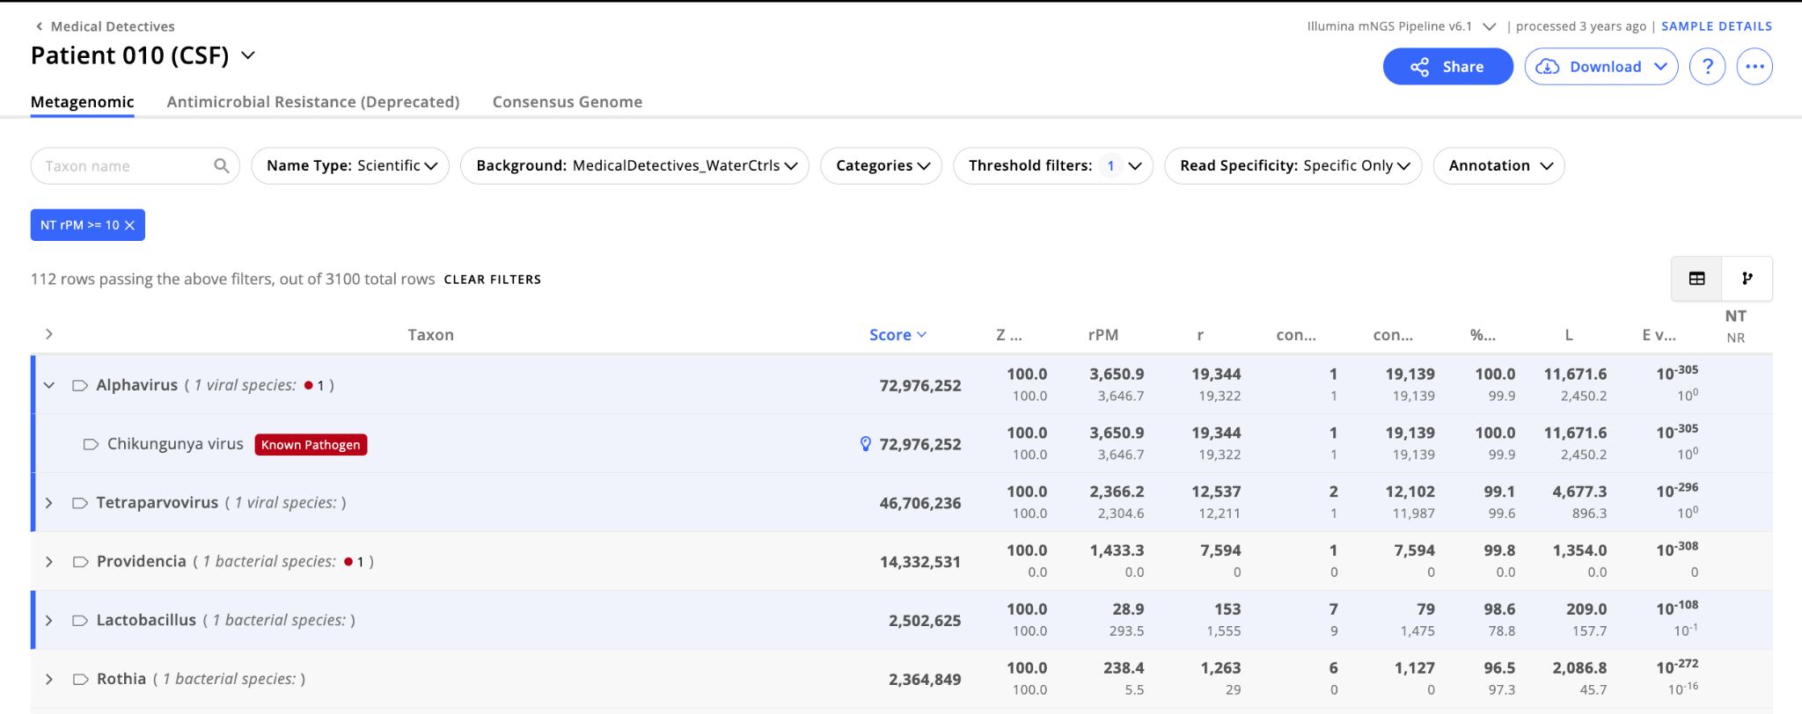
...to here?

Slide 11
Pipeline Overview

Slide 12
Raw reads
Pipeline Goal
Assign quality filtered reads to taxa by mapping or aligning against reference databases
Assemble contigs and map reads to contigs to increase support for identified taxa (assembly-based alignment)

Slide 13
Pipeline Basics
Assembly
Sequence alignment against reference database(s)
Reference database(s)

Slide 14
Sequence assembly into contigs
Assembly goal: Merge sequence reads into contigs to form longer DNA sequences and reconstruct the original sequence
Microbial Genome Sequence
Sequencing Reads
Assembled Contigs

Slide 15
Sequence assembly into contigs
Assembly goal: Merge sequence reads into contigs to form longer DNA sequences and reconstruct the original sequence
Microbial Genome Sequence
Sequencing Reads
Assembled Contigs
ATGGACTCATTCGGTCG
TGATAGTTCCTAGATAC
TCGAATAGTAGCCTGAT
ATGGACTCATTCGGTCGAATAGTAGCCTGATAGTTCCTAGATAC

Slide 16
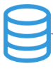
Sequence alignment against database
Alignment goal: Query unknown sequences against a reference database of known sequences to identify the microbe of origin
Unknown sequence
Database of known sequences
> seq_1, unknown
CTCATTCGGT
> species A
GCCTCGATCTGTAGCCT
> species B
ATGGACTCATTCGGTCG
> species C
TGCTAAATCGCGCCCTA
> species D
TGGCTAAGTCATATAGC

Slide 17
Sequence alignment against database
Alignment goal: Query unknown sequences against a database of known sequences to identify the microbe of origin
Unknown sequence
Database of known sequences
Sequence Alignment
> seq_1, unknown
CTCATTCGGT
> species A
GCCTCGATCTGTAGCCT
> species B
ATGGACTCATTCGGTCG
> species C
TGCTAAATCGCGCCCTA
> species D
TGGCTAAGTCATATAGC
> species A
GCCTCGATCTGTAGCCT
||| | ||
CTCATTCGGT
> species B
ATGGACTCATTCGGTCG
||||||||||
CTCATTCGGT
> species C
TGCTAAATCGCGCCCTA
|| | |||
CTCATTCGGT
> species D
TGGCTAAGTCATATAGC
|||| |
CTCATTCGGT

Slide 18
Sequence alignment against database
Alignment goal: Query unknown sequences against a database of known sequences to identify the microbe of origin
Unknown sequence
Database of known sequences
Sequence Alignment
> seq_1, unknown
CTCATTCGGT
> species A
GCCTCGATCTGTAGCCT
> species B
ATGGACTCATTCGGTCG
> species C
TGCTAAATCGCGCCCTA
> species D
TGGCTAAGTCATATAGC
> species A
GCCTCGATCTGTAGCCT
||| | ||
CTCATTCGGT
> species B
ATGGACTCATTCGGTCG
||||||||||
CTCATTCGGT
> species C
TGCTAAATCGCGCCCTA
|| | |||
CTCATTCGGT
> species D
TGGCTAAGTCATATAGC
|||| |
CTCATTCGGT
Seq_1 = Species B

Slide 19
CZ ID uses NCBI reference databases
NCBI houses a series of databases containing annotated collections of publicly available sequences
 | NT Database | NR Database
What does NT/NR mean? | NT = nucleotide | NR = non-redundant protein

Slide 20
CZ ID uses NCBI reference databases
NCBI houses a series of databases containing annotated collections of publicly available sequences
 | NT Database | NR Database
What does NT/NR mean? | NT = nucleotide | NR = non-redundant protein
What is in the database? | Contains all nucleotide sequences (RefSeq records plus all GenBank sequences except for those from the EST, GSS, STS and HTG divisions). | Contains non-redundant set of all CDS translations from GenBank along with all RefSeq, UniProtKB/Swiss-Prot, PDB and PRF proteins. Note: does not contain rRNA sequences given that these do not encode proteins

Slide 21
CZ ID uses NCBI reference databases
NCBI houses a series of databases containing annotated collections of all publicly available sequences (GenBank)
 | NT Database | NR Database
What does NT/NR mean? | NT = nucleotide | NR = non-redundant protein
What is in the database? | Contains nucleotide sequences (RefSeq records plus all GenBank sequences except for those from the EST, GSS, STS and HTG divisions). | Contains non-redundant set of coding sequence translations from GenBank along with all RefSeq, UniProtKB/Swiss-Prot, PDB and PRF proteins. Note: does not contain rRNA sequences given that these do not encode proteins
How does it influence analysis? | NT hits tend to be more accurate for most organisms (bacteria, eukaryotes, viruses with close relatives in the DB) | NR alignments are especially good for detecting divergent viruses, since mutations in the NT sequence accumulate faster than the amino acid sequence

Slide 22
Where would you see the following E. coli matches?
E. coli polymerase
E. coli 16S rRNA
 | NT Database | NR Database
Match (or hit) to E. coli based on…

Slide 23
Where would you see the following E. coli matches?
E. coli polymerase
E. coli 16S rRNA
 | NT Database | NR Database
Match (or hit) to E. coli based on… | 16S rRNA Polymerase | Polymerase

Slide 24
CZ ID mNGS Pipeline Walkthrough

Slide 25
Raw reads

Slide 26
Raw reads
Step 1: QC and Host Filtering
Truncate to 150 million reads (PE data) or 75 million reads (SE data)
Filter out low quality reads, low complexity reads, and adapters (fastp)
Host read removal (Bowtie followed by HISAT2)
Human read removal (Bowtie followed by HISAT2)
Collapse duplicate reads (CZID-dedup)
Subsampling to 2 million PE reads or 1 million SE
Filtering
Bioinformatic tool/software

Slide 27
Reads mapped to accessions
Raw reads
Unmapped reads
Filtering
Alignment
BLAST Database
Step 2: Read alignment against NCBI databases
Reads are mapped against nucleotide (NT) and protein (NR) databases to obtain a preliminary accession for each read (minimap2 and DIAMOND).
Generate custom BLAST database containing all taxa identified as preliminary accessions.
Bioinformatic tool/software

Slide 28
Reads mapped to accessions
Raw reads
Short reads
Unmapped reads
Contig
Filtering
Alignment
Assembly
BLAST Database
Step 3: Assemble contigs and map reads to contigs
Assemble reads into contigs using de novo assembly (SPAdes).
Align reads to assembled contigs (Bowtie2).
Bioinformatic tool/software

Slide 29
Reads mapped to accessions
Raw reads
Short reads
Unmapped reads
Contig
species A
Filtering
Alignment
Assembly
BLAST
species B
species C
species D
BLAST Database
Step 4: Align contigs against custom database
Align contigs against database of preliminary accessions generated in the previous step (BLAST)
Bioinformatic tool/software

Slide 30
Reads mapped to accessions
Report summary
Raw reads
Short reads
Unmapped reads
Contig
species A
Filtering
Alignment
Assembly
BLAST
species B
Map to Taxa
species C
species D
BLAST Database
Step 5: Mapping to taxa
Assign each read a final accession based on:
1. Contig accession, or
2. Initial read accession (if the read did not assemble into a contig)
Assign each contig/unassembled read to a taxon using NCBI taxon IDs
Compute statistics (e.g., reads per million for each taxon)
Notes:
Accessions are assigned based on contigs unless reads did not align to contigs (those taxa will be assigned based on read hits)

Slide 31
Reads mapped to accessions
Raw reads
Short reads
Unmapped reads
Contig
species A
Filtering
Alignment
Assembly
BLAST
species B
Map to Taxa
species C
species D
BLAST Database
CZ ID GitHub Repositories:
czid-web - Frontend portal
czid-workflows - Bioinformatics workflows
czid-cli - Command line upload interface
czid-bench - Pipeline benchmarking tools
Pipeline visualization

Slide 32
Let’s talk about QC next…
Next Slides: DL5-I_QC and interpretation slides for Illumina

